Slide 1
Sketching with Hardware
05: Arduino

Slide 2
Day 2: Tuesday, xx.yy.
09:00 Introduction: Arduino
09:30 Hands-on: Arduino
11:00 Small Project
13:00 Lunch Break
14:00 Programming
15:00 Extensive Task
17:00 End

Slide 3
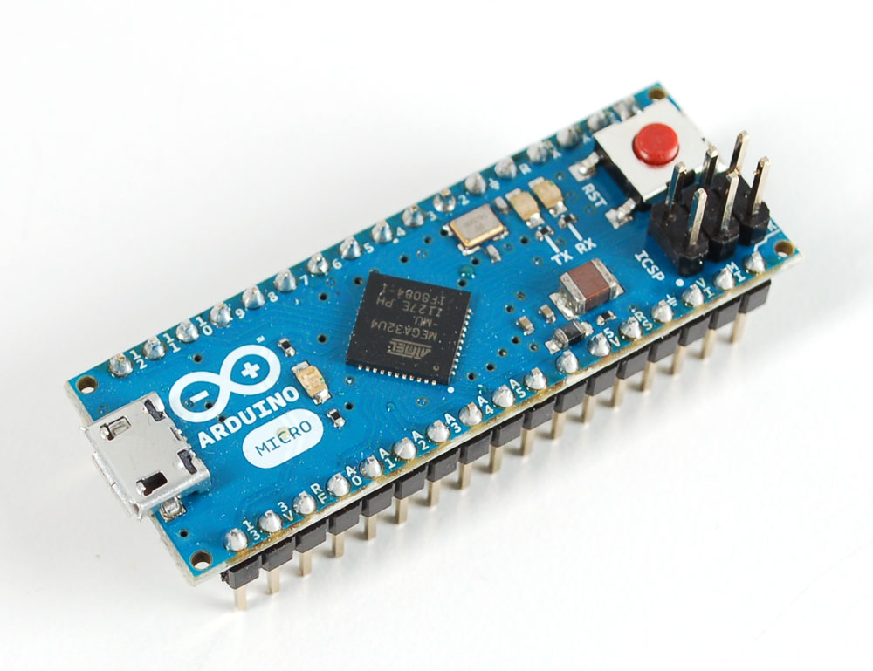
Arduino Micro
Reset Button
Status LEDs
programmable LED
CPU
Pin Headers
USB Socket

Slide 4
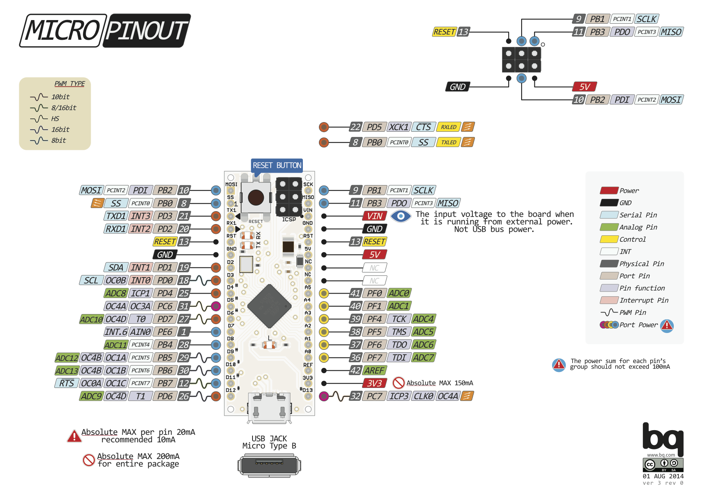
Image: Arduino Forum, User pighixxx, http://forum.arduino.cc/index.php?topic=148734.0

Slide 5
Arduino IDE
https://www.arduino.cc/en/Main/Software
Download and install the current version
Plug in the Arduino via USB
Tools → Board → Arduino Micro
File → Examples → Basic → Blink
Upload the sketch (upload button or ctrl + u)

Slide 6
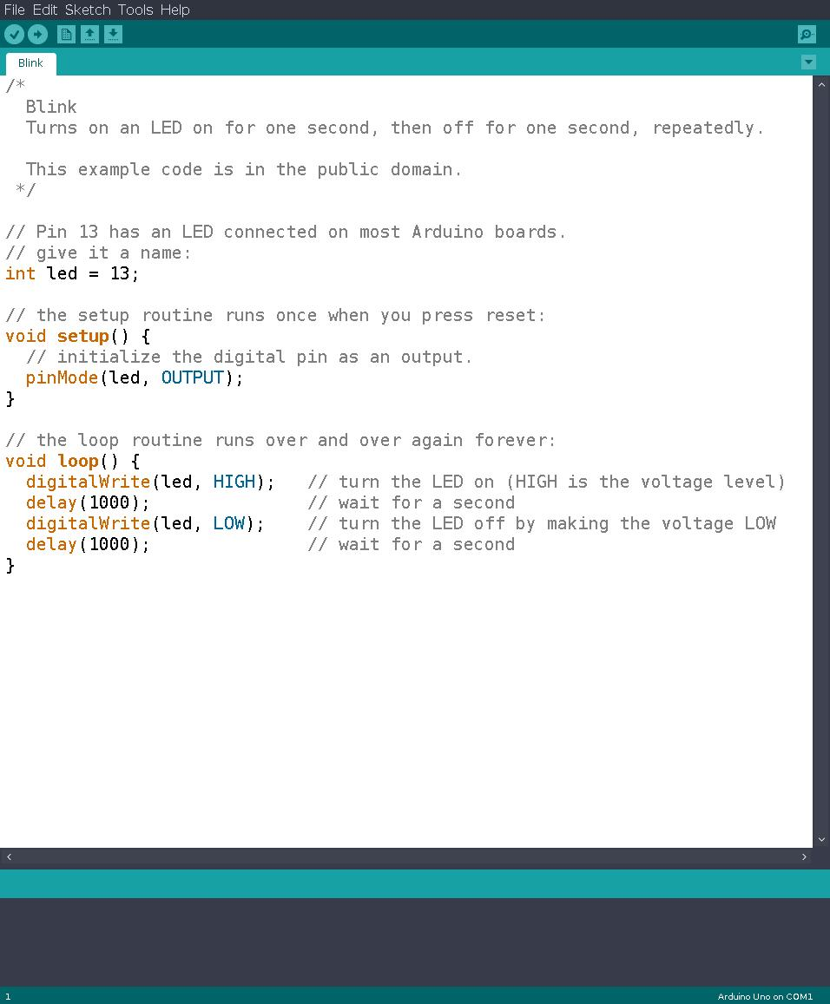
Upload

Slide 7
Hello World: Blink
// Pin 13 has an LED connected on most Arduino boards.
int led = 13;
// the setup routine runs once when you press reset:
void setup() {
// initialize the digital pin as an output.
pinMode(led, OUTPUT);
}
// the loop routine runs over and over again forever:
void loop() {
digitalWrite(led, HIGH); // turn the LED on (HIGH is the voltage level)
delay(1000); // wait for a second
digitalWrite(led, LOW); // turn the LED off by making the voltage LOW
delay(1000); // wait for a second }

Slide 8
Tutorial 04: Arduino

Slide 9
Why do we use dedicated ICs?
Simple circuits can be built cheaper and easier
Arduino: 5 – 30€
Simple IC: < 1€
Expand the possibilities of Arduino (and others)
Multitude of specialized chips, e.g. for audio playback, sensors, FPGA, etc.

Slide 10
Some Tips
Arduino is well documented – use the documentation!
Keep things tidy (code and hardware)
Keep your code expandable

Slide 11
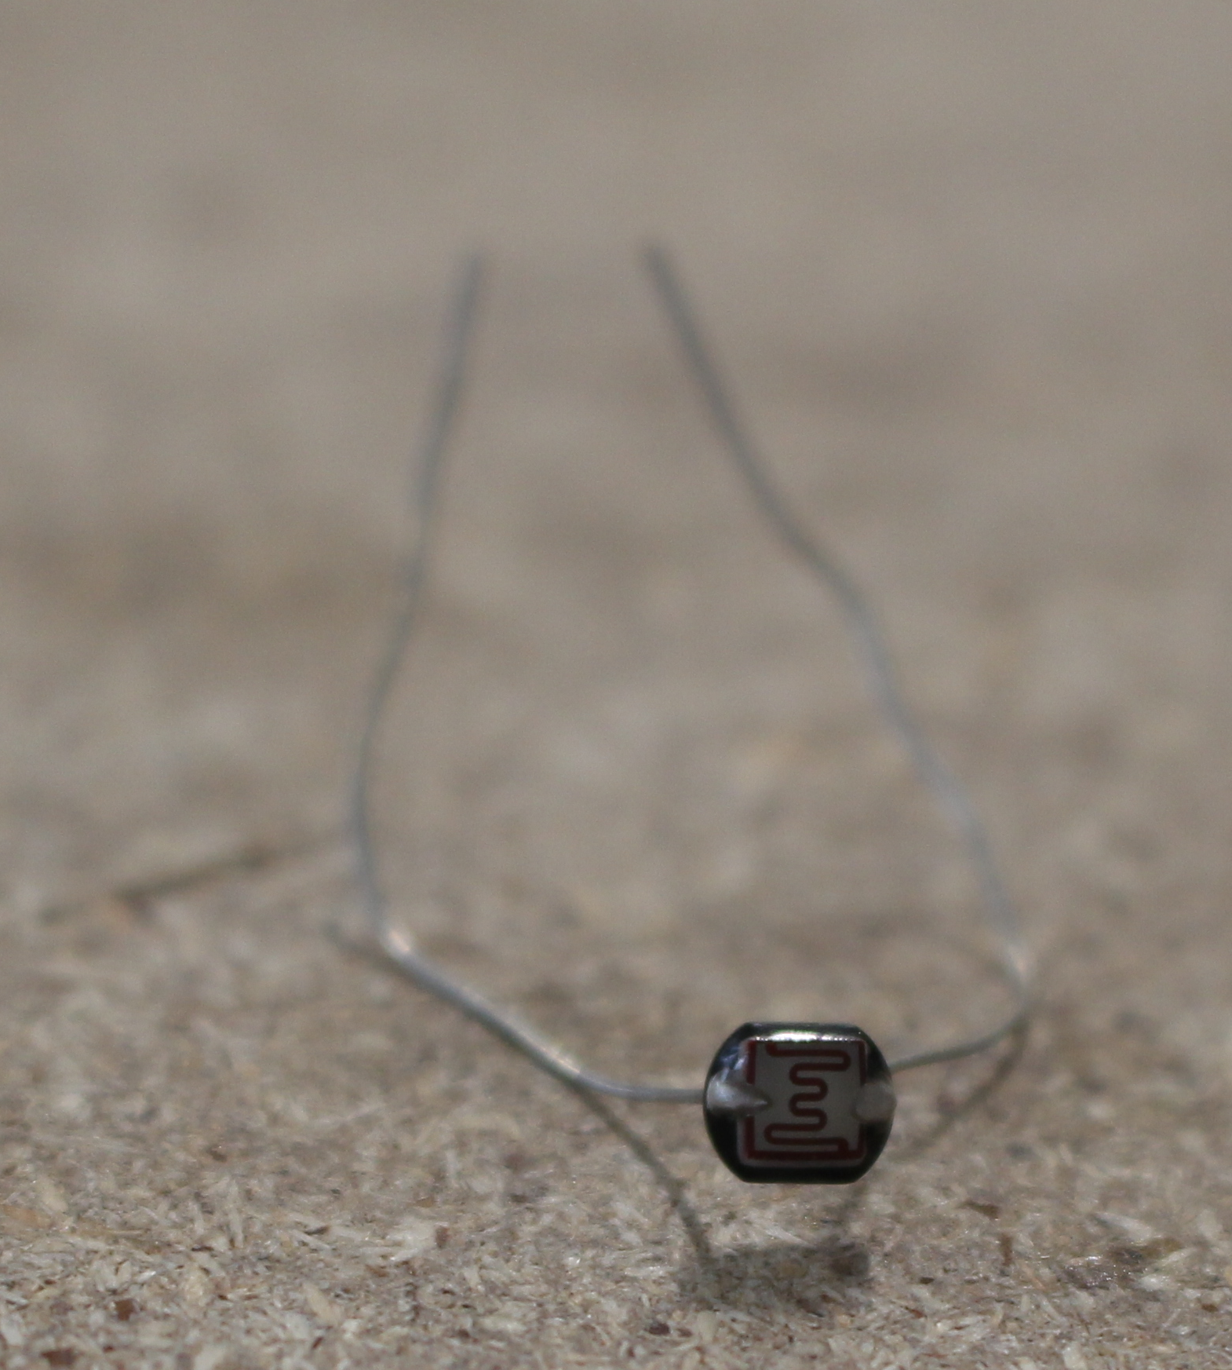
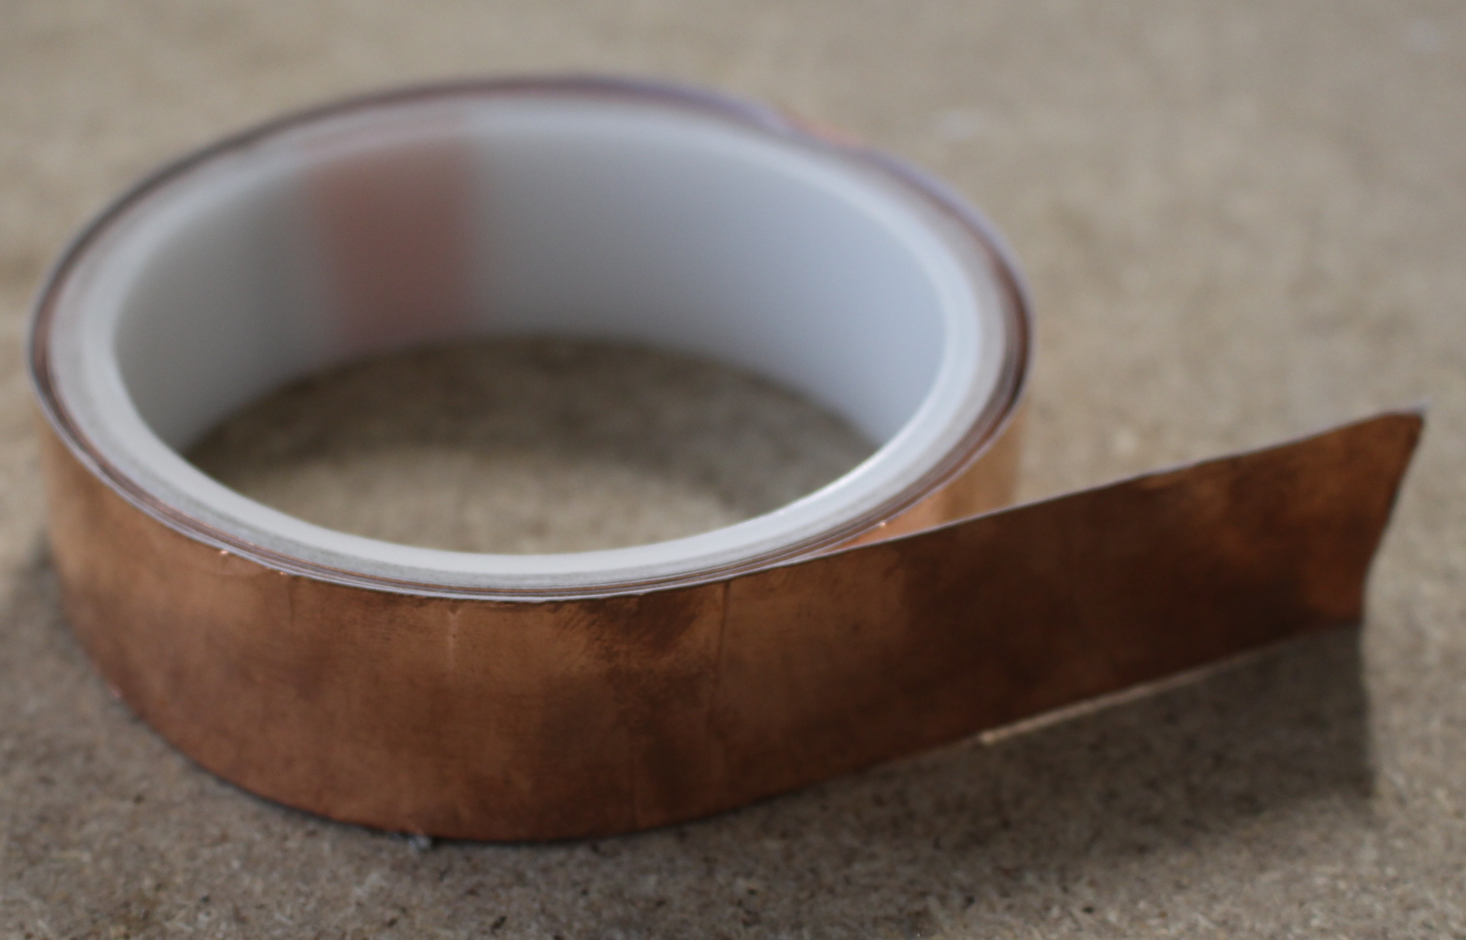
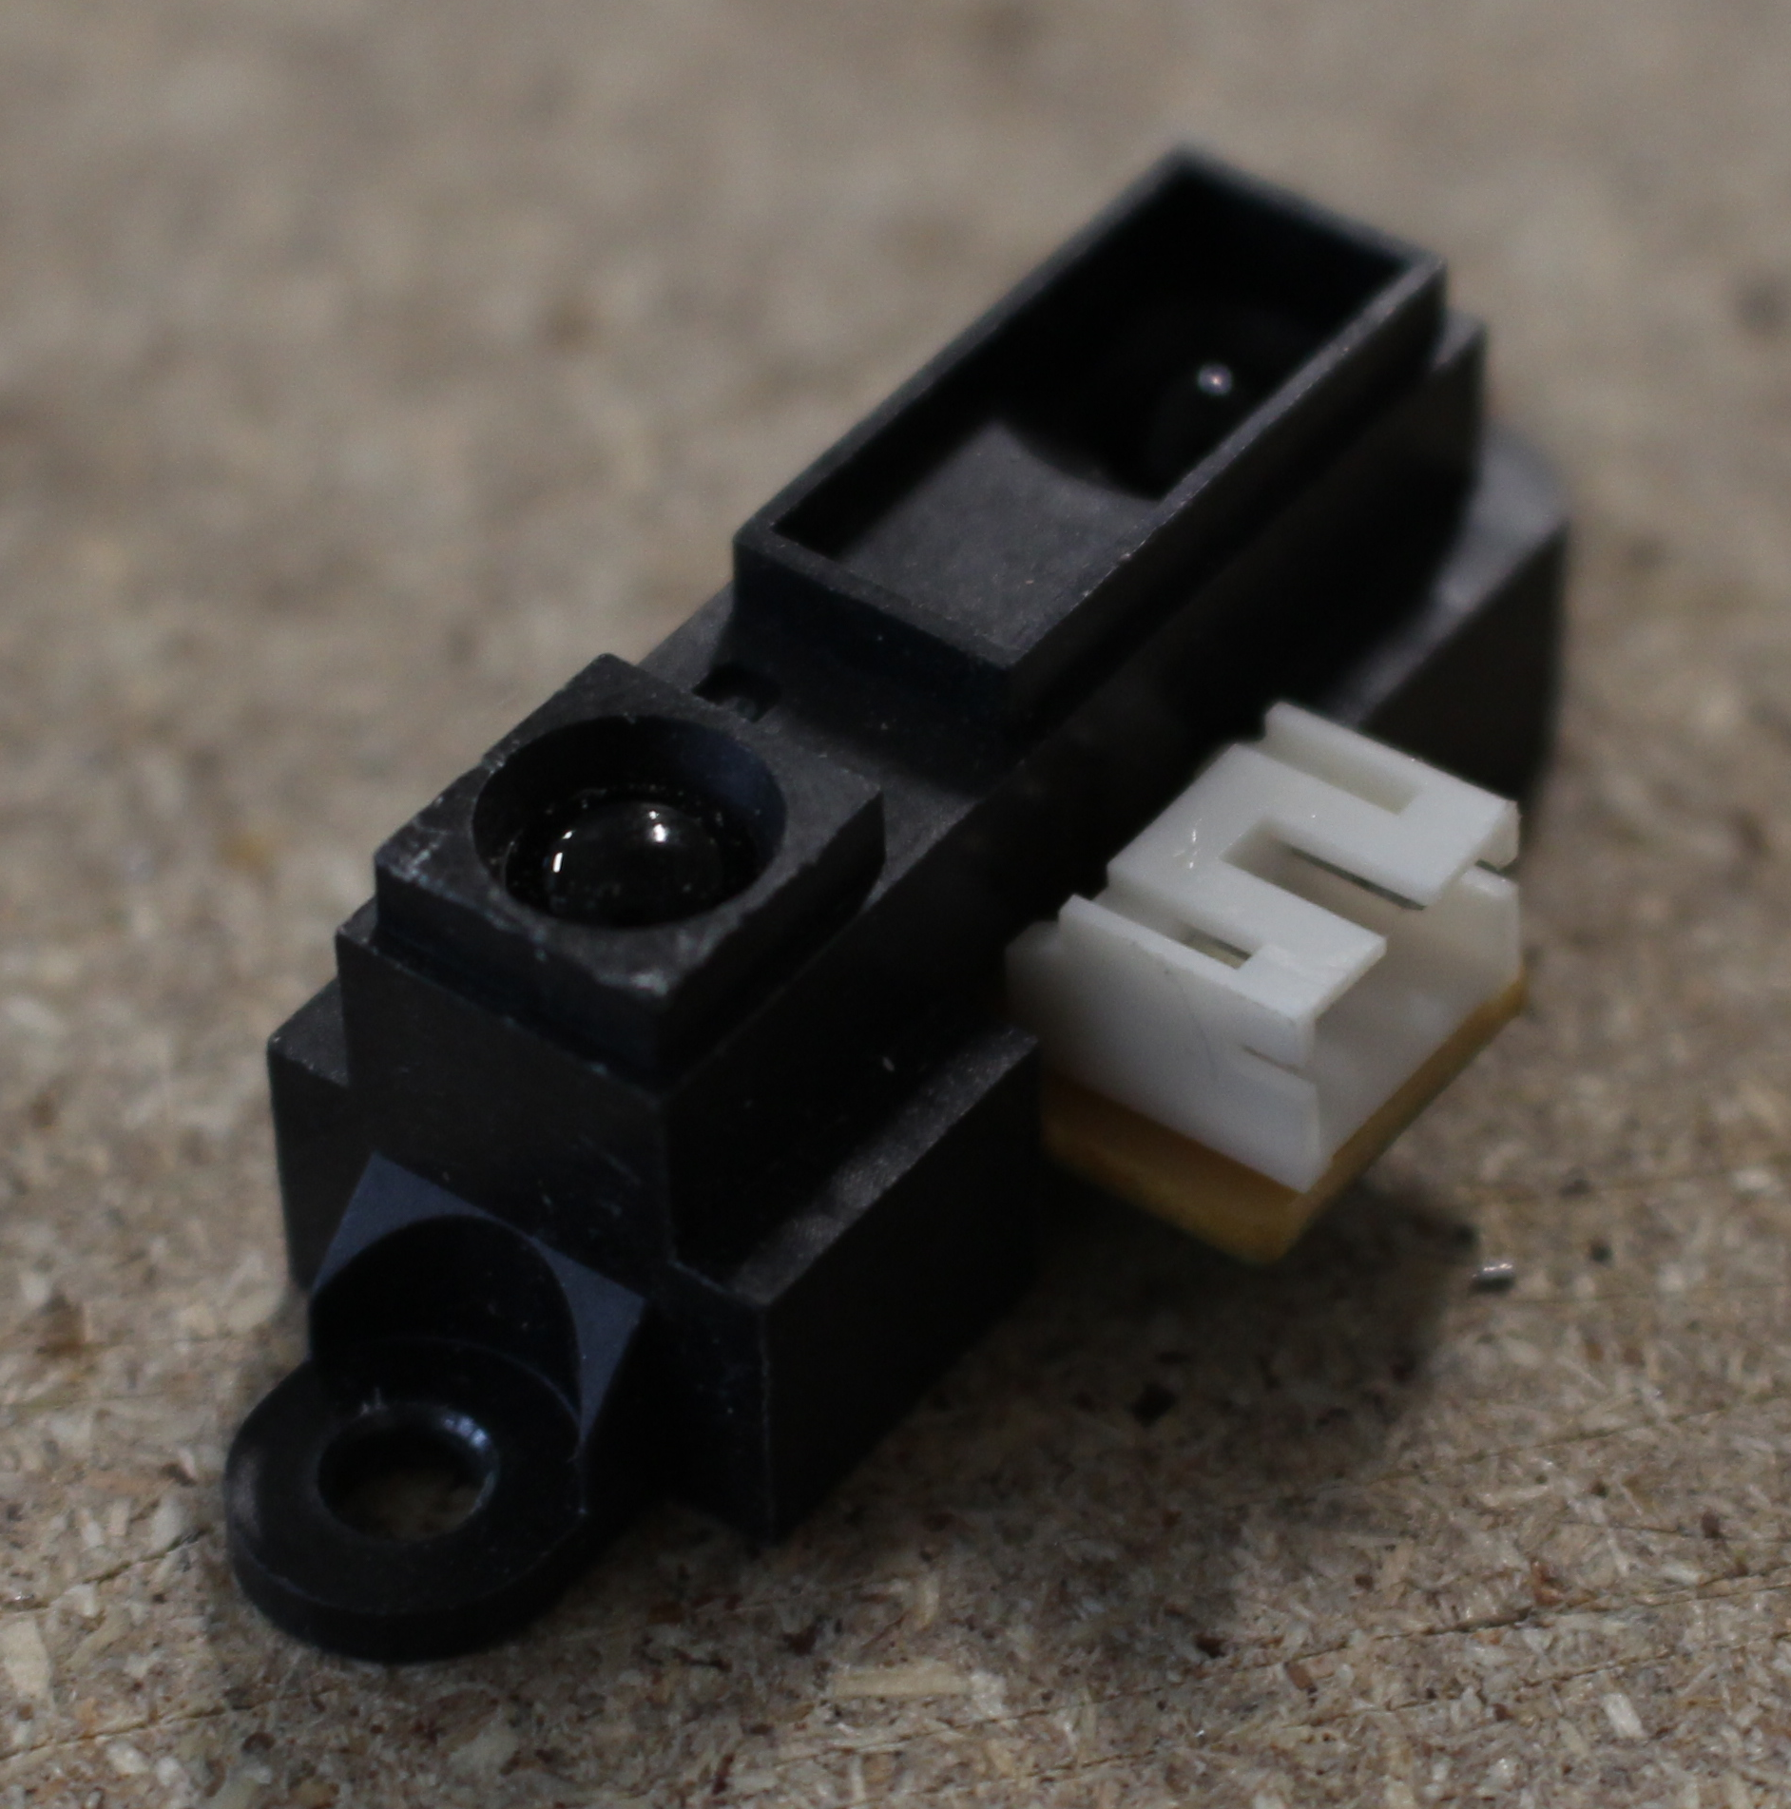
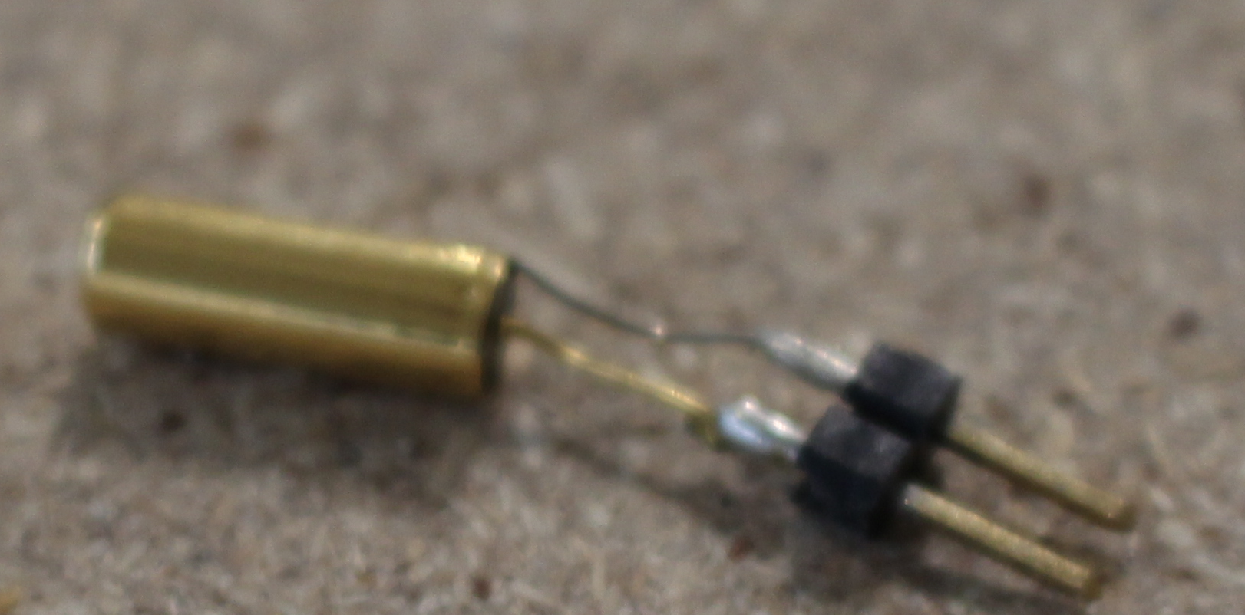
New components...
Photoresistor
Copper tape
Distance sensor
Tilt switch

Slide 12
Exercise: Custom Input Device
The Arduino Micro can emulate a mouse or keyboard
Read the documentation: https://www.arduino.cc/en/Reference.MouseKeyboard
Build a custom input device for a simple (!) video game of your choice

